Slide 1
Content
Algorithms testing I
Random walk (original)
Random walk (modified)
Cliff (original)
Cliff (modified)
Algorithms testing II
Chain walk
Roadmap: where are we going?
DANIEL GARCÍA-OCAÑA HERNÁNDEZ

Slide 2
Content
ALGORITHMS TESTING
RANDOM WALK (ORIGINAL)
RANDOM WALK (MODIFIED)
CLIFF (ORIGINAL)
CLIFF (MODIFIED)
Algorithms testing II
Chain walk
Roadmap: where are we going?

Slide 3

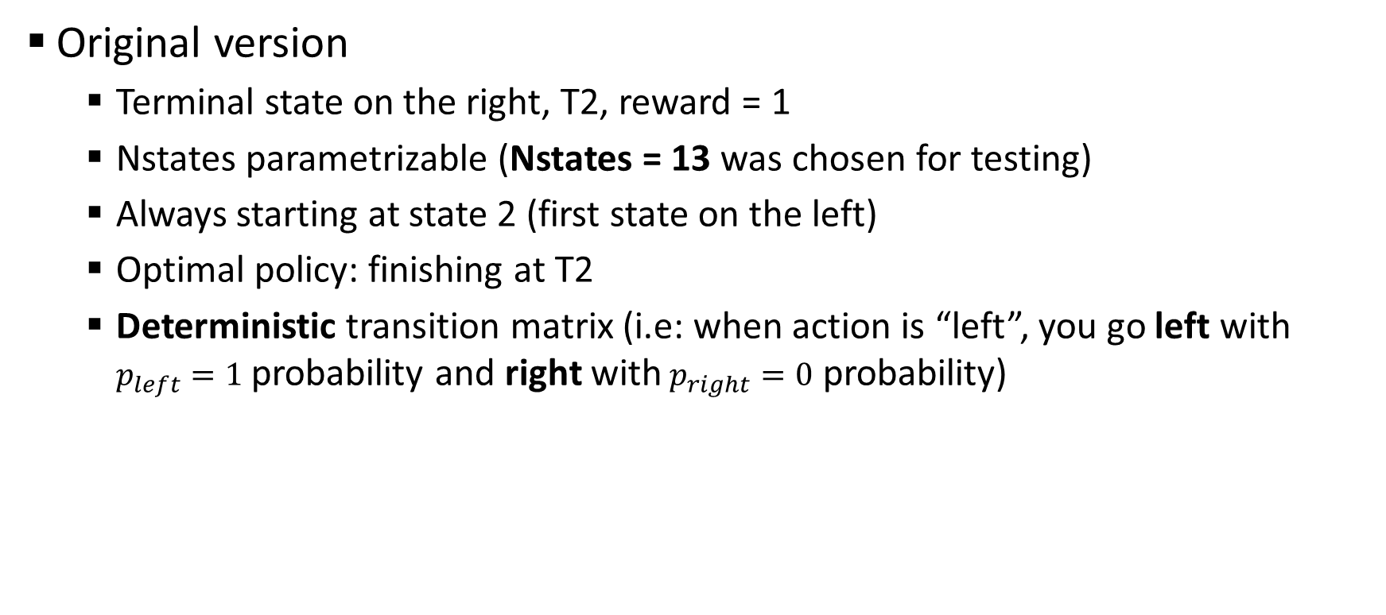
Random walk (original)
Original version
Terminal state on the right, T2, reward = 1
Nstates parametrizable (Nstates = 13 was chosen for testing)
Always starting at state 2 (first state on the left)
Optimal policy: finishing at T2
Deterministic transition matrix (i.e: when action is “left”, you go left with $p_{left}=1$ probability and right with$p_{right}=0$ probability)
T1
T2

Slide 4
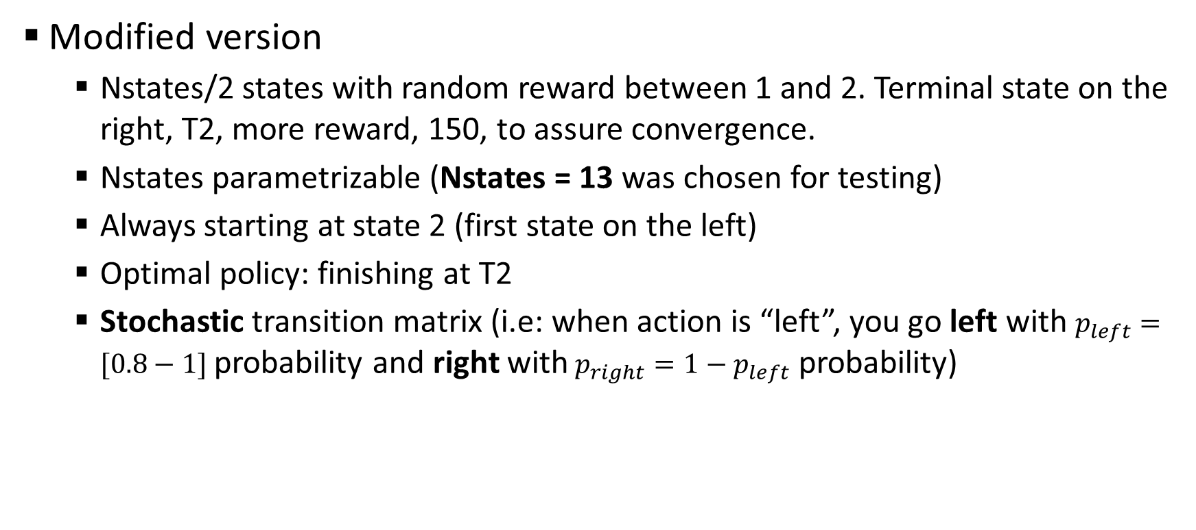
Random walk (modified)
Modified version
Nstates/2 states with random reward between 1 and 2. Terminal state on the right, T2, more reward, 150, to assure convergence.
Nstates parametrizable (Nstates = 13 was chosen for testing)
Always starting at state 2 (first state on the left)
Optimal policy: finishing at T2
Stochastic transition matrix (i.e: when action is “left”, you go left with $p_{left}=[0.8−1]$ probability and right with$p_{right}=1−p_{left}$ probability)
T1
T2

Slide 5
Random walk (original - deterministic)
Comparison between DA TD (model-free), SARSA and Q-learning. All of them with optimal parameters.
Epsilon = 0 después de cada episodio
Zoom a 200 y línea vertical
¿Comparar también con model-based?

Slide 6
Random walk (modified - stochastic) (I)
¿Comparar también con model-based?

Slide 7
Random walk (modified - stochastic) (II)
¿Comparar también con model-based?

Slide 8
Cliff walking (modified)
Modified version
Take the action you want to with a probability p_good = [0.7-1], take another action with probability p_bad = (1-p_good)/3.

Slide 9
Cliff (original - deterministic)
REWARD MUY BRUSCA

Slide 10
Cliff (modified - stochastic) (I)

Slide 11
Cliff (modified - stochastic) (II)

Slide 12
Cliff (modified - stochastic) (III)

Slide 13
Content
Algorithms testing
Random walk (original)
Random walk (modified)
Cliff (original)
Cliff (modified)
Algorithms testing II
Chain walk
Roadmap: where are we going?
Future lines (18/05/2017)

Slide 14
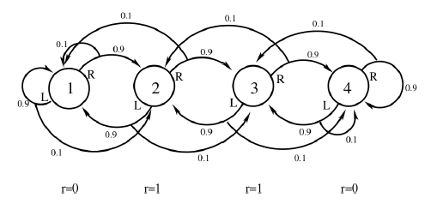
Chain walk

Slide 15
Chain walk (I)

Slide 16
Chain walk (II)

Slide 17
Chain walk – curious… (III)

Slide 18
Chain walk – curious… (IV)

Slide 19
Content
Algorithms testing I
Random walk (original)
Random walk (modified)
Cliff (original)
Cliff (modified)
Algorithms testing II
Chain walk
ROADMAP: WHERE ARE WE GOING?

Slide 20
Roadmap: where are we going?
Algorithm… | Compare with… | Problems to test with…
Dual-Ascent (DA): Model based → exact solution (DP) Model free → stochastic gradient (RL) | SARSA Q-learning Double Q-learning | Random walk (classical) Random walk (modified) Cliff
DA with Linear Function Approximation (DA-LFA) | LSPI | Chain walk (RL course version) Mountain car
DA with Non-Linear Function Approximation (DA-NLFA) | Deep Q-learning (DQN) Neural fitted Q-iteration (NFQ) | Mountain Car
¡¡CONTINUOUS STATE SPACE!!
Neural networks
Python
OpenAI

